Slide 1

Batching, token embedding, and positional encoding
A lecture by Maneesha Rajapaksha

Slide 2
3 steps
4.
x = [t0, t1, t2, t3]
y = [t1, t2, t3, t4]
y is just x shifted by 1
raw text → tokens
tokens → x and y
batching
1.
data.txt:
"I love AI. AI loves data."
5.
batch_size = 2
block_size = 4 (gpt 2 -1024)
x:
[
[t0, t1, t2, t3],
[t1, t2, t3, t4]
]
y:
[
[t1, t2, t3, t4],
[t2, t3, t4, t5]
]
2.
"I love AI. AI loves data."
↓
[40, 502, 1234, 13, 1234, 789, 456, 13]
3.
block_size = 4
Sequence 1: [t0, t1, t2, t3]
Sequence 2: [t1, t2, t3, t4]
Sequence 3: [t2, t3, t4, t5]
This is called a sliding window over tokens

Slide 3
import torch
import tiktoken
with open('data.txt', 'r', encoding='utf-8') as f:
text = f.read()
enc = tiktoken.get_encoding("gpt2")
tokens = enc.encode(text)
data = torch.tensor(tokens, dtype=torch.long)
block_size = 8
batch_size = 4
def get_batch(data):
ix=torch.randint(len(data)-block_size-1,(batch_size,))
x=torch.stack([data[i:i+block_size]for i in ix])
y=torch.stack([data[i+1:i+block_size+1]for i in ix])
return x,y
x, y = get_batch(data)

Slide 4
import torch
from torch.utils.data import Dataset, DataLoader
import tiktoken
class GPTDataset(Dataset):
def __init__(self, text, block_size, stride):
enc = tiktoken.get_encoding("gpt2")
tokens = enc.encode(text)
self.data = torch.tensor(tokens, dtype=torch.long)
self.block_size = block_size
self.stride = stride
self.samples = []
for i in range(0, len(self.data) - block_size - 1, stride):
x = self.data[i:i+block_size]
y = self.data[i+1:i+block_size+1]
self.samples.append((x, y))
def __len__(self):
return len(self.samples)
def __getitem__(self, idx):
return self.samples[idx]
with open("data.txt", "r", encoding="utf-8") as f:
text = f.read()
block_size = 8
stride = 4
batch_size = 4
dataset = GPTDataset(text, block_size, stride)
loader = DataLoader(
dataset,
batch_size=batch_size,
shuffle=True
)
for x, y in loader:
print(x.shape, y.shape)
break

Slide 5
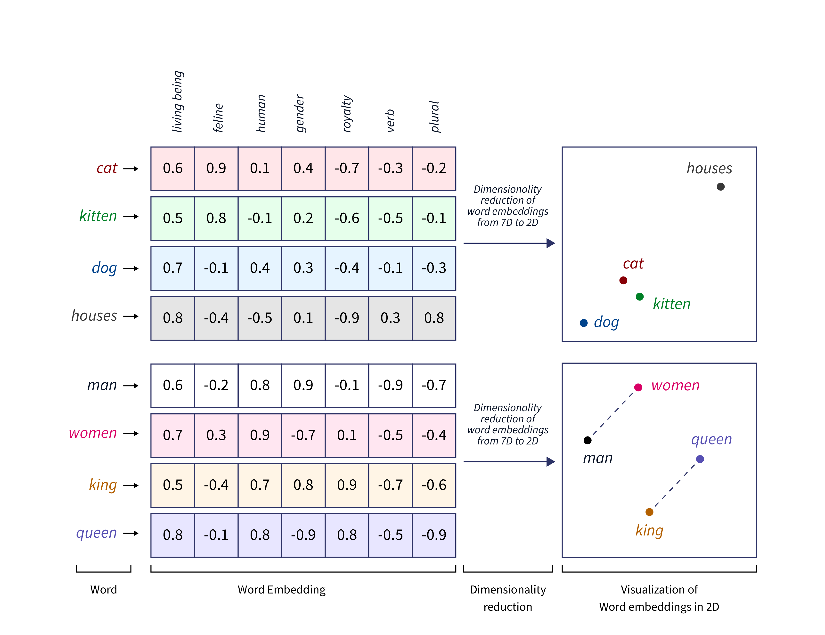
Token embeddings

Slide 6
import torch vocab_size = 6 output_dim = 3 token_embedding_layer = torch.nn.Embedding(vocab_size, output_dim) print(token_embedding_layer.weight)
data_iter = iter(loader)
inputs, targets = next(data_iter)
token_embeddings = token_embedding_layer(inputs)
print(token_embeddings.shape)
Parameter containing:
tensor([[-0.8068, -0.6655, -1.4995],
[-1.4348, -0.8587, 2.0301],
[-0.6179, -1.6250, -0.1482],
[-0.0923, -1.7586, -0.5960],
[-0.8365, 1.6584, -0.2558],
[-1.1955, 0.4225, -0.6651]], requires_grad=True)

Slide 7
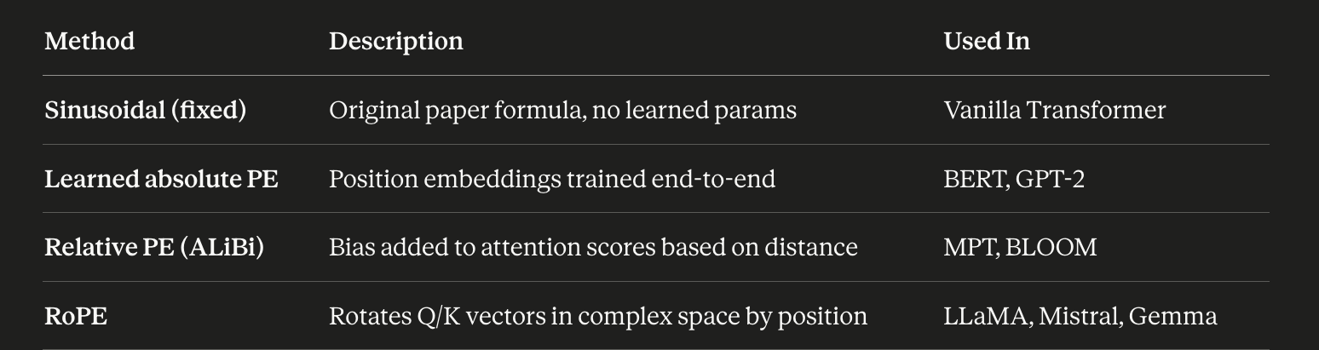
Encoding word positions
Transformers process all tokens in parallel — unlike RNNs, there's no inherent left-to-right pass that would naturally encode order. Self-attention is permutation-invariant: swap "cat sat on the mat" to "mat on the cat sat", and without extra information, the model sees the same set of vectors.
Positional encoding (PE) solves this by injecting position information directly into each token's embedding before it enters the attention layers.
pos_embedding_layer = torch.nn.Embedding(context_length, output_dim)
pos_embeddings = pos_embedding_layer(torch.arange(context_length))
input_embeddings = token_embeddings + pos_embeddings
print(input_embeddings.shape)

